Slide 1

DS 2003: Communicating with Data
Class 3: Descriptive Statistics

Slide 2

Descriptive Statistics
Measures of Center: mean, median, mode
Measures of Spread: standard deviation, variance, range interquartile range
Measures of Relationship Between Variables: covariance and correlation
Population
Inference
Sample
Data Collection

Slide 3
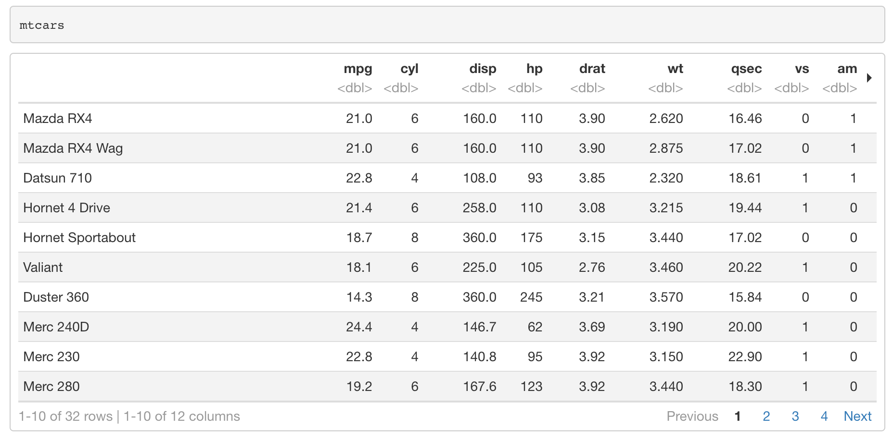
Example Data
Columns of a dataframe are accessed by the “$” operator
> mtcars$mpg

Slide 4
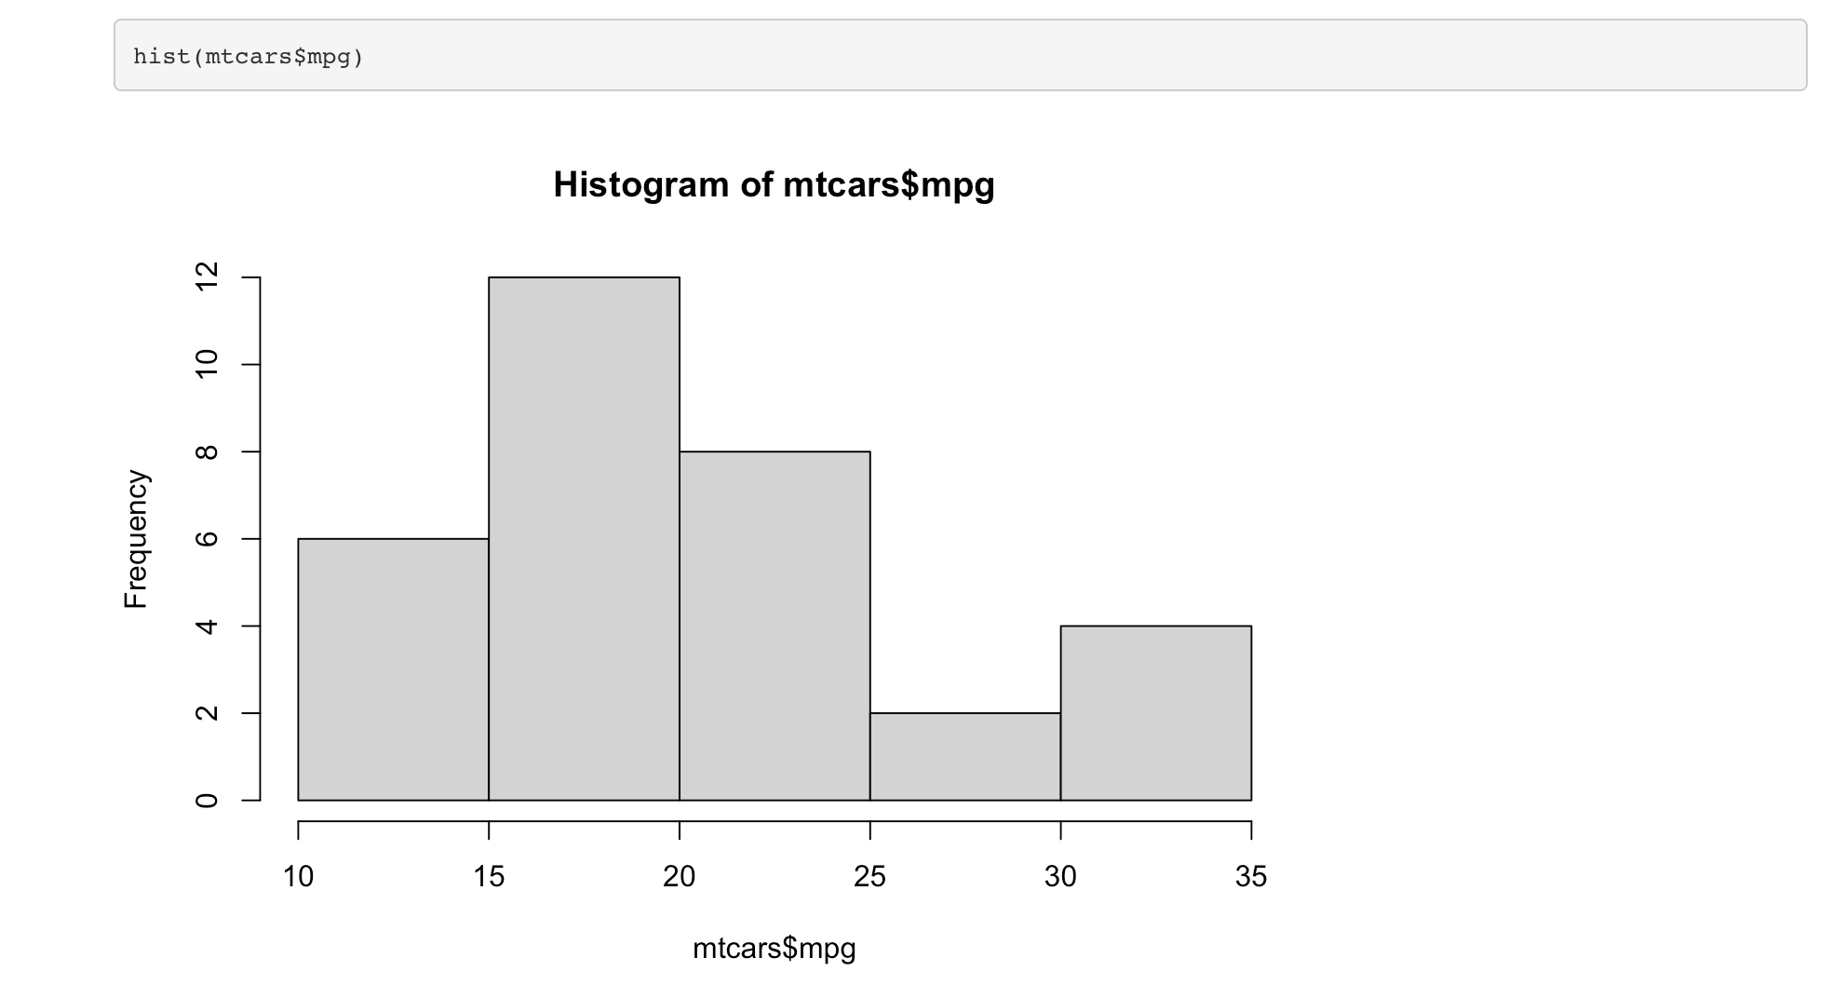
Example Data
We want to summarize the mpg variable
Check the mpg variable

Slide 5
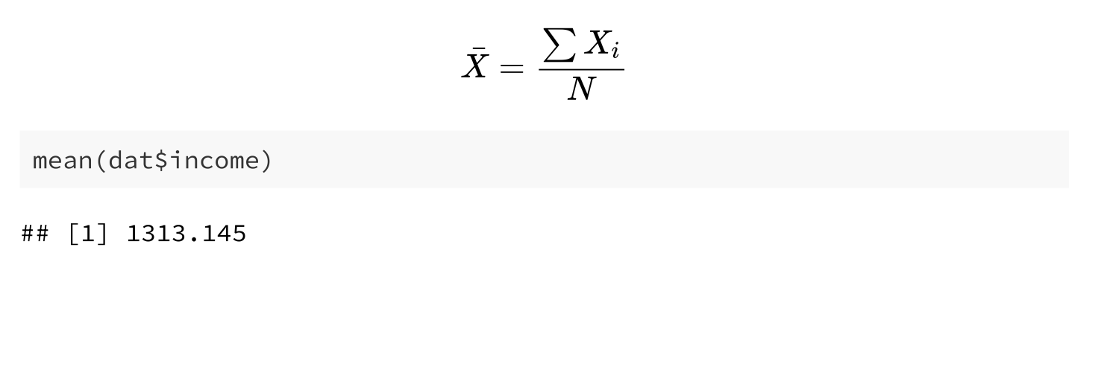
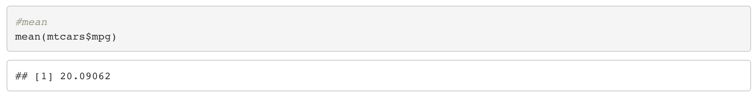
Measures of Center: Mean
The mean is the average of a data set

Slide 6
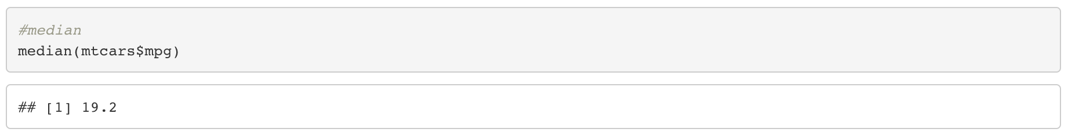
Measures of Center: Median
The median is the middle of the set of numbers

Slide 7
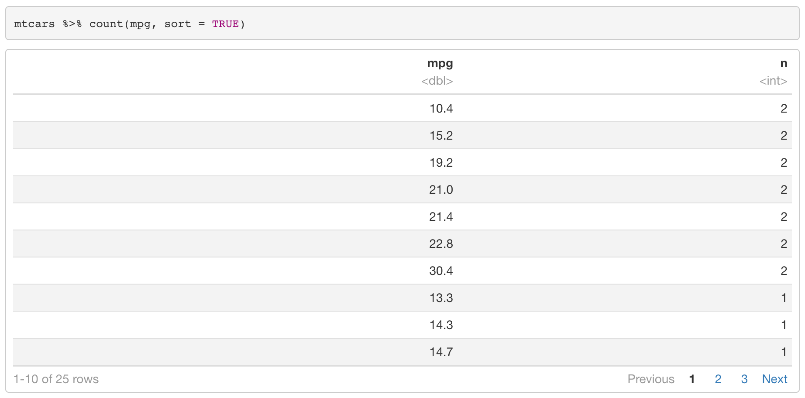
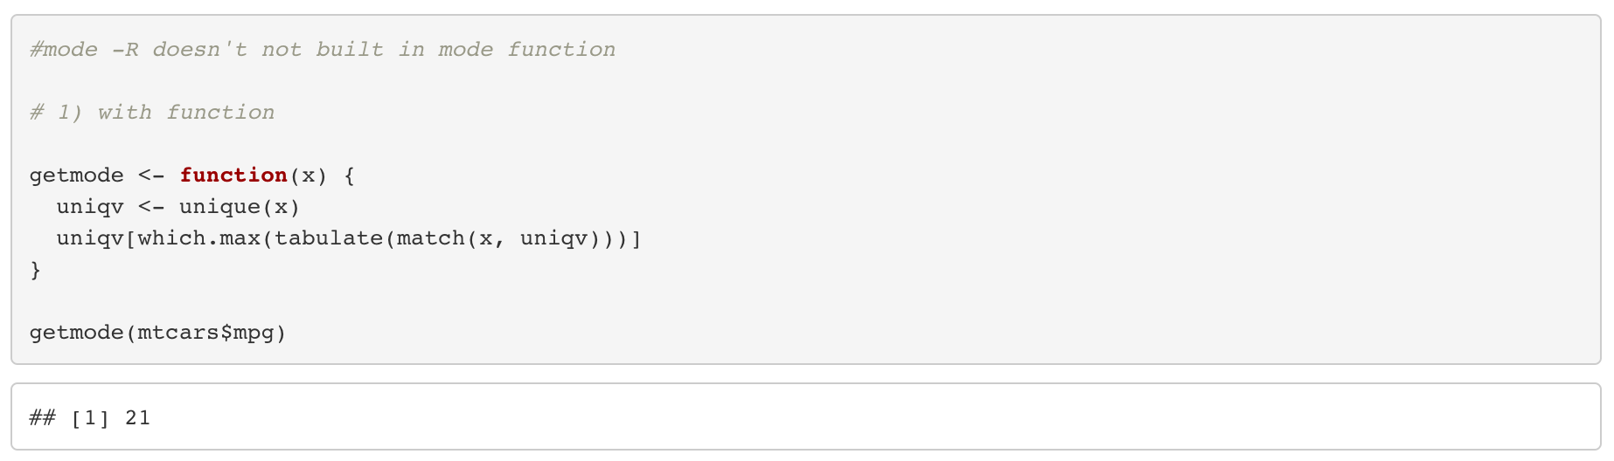
Measures of Center: Mode
The mode is the most common number in a data set
R does not have a standard in-built function to compute
with count & sort
with a function

Slide 8
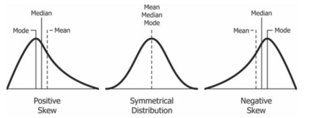
Measures of Center: Effect of Outliers
The mean is more sensitive to outliers

Slide 9
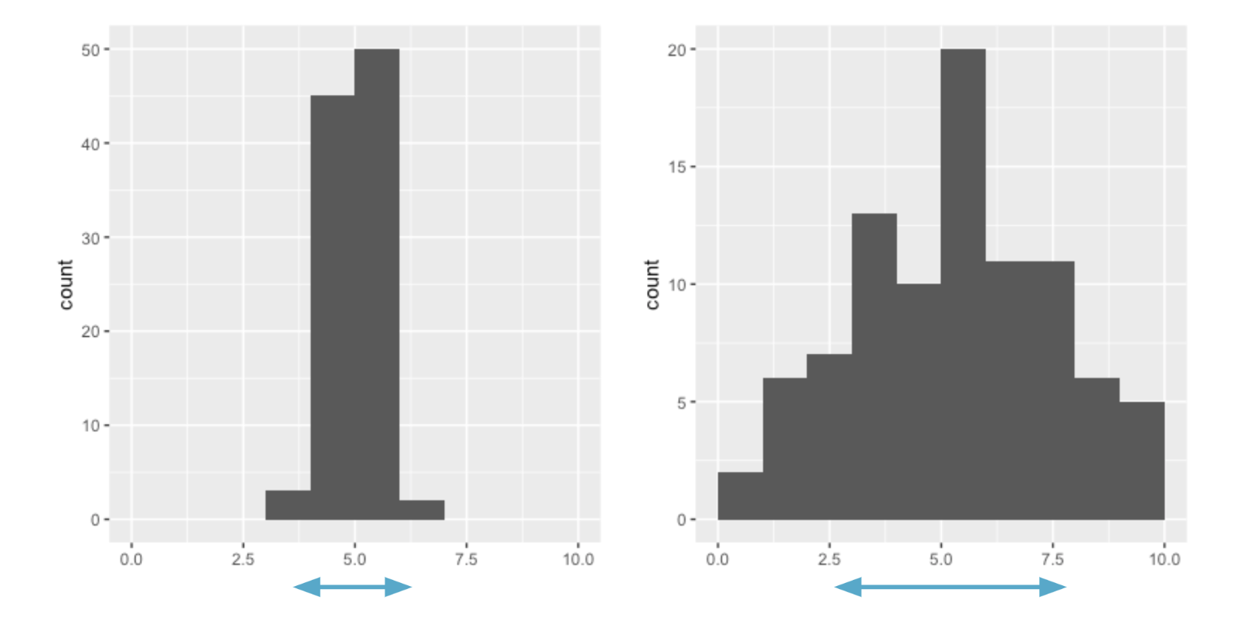
Measures of Spread

Slide 10
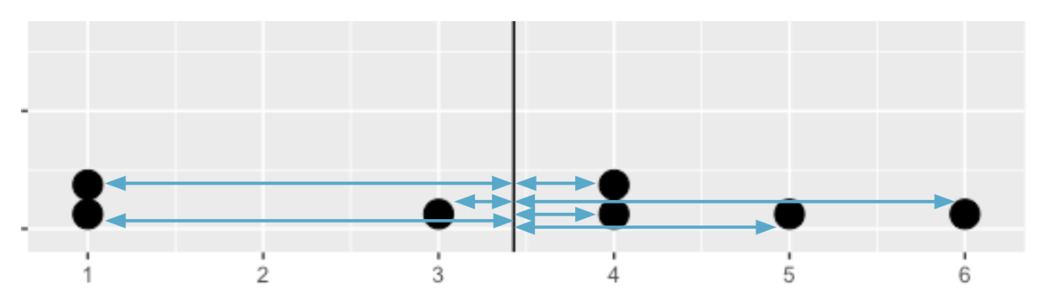
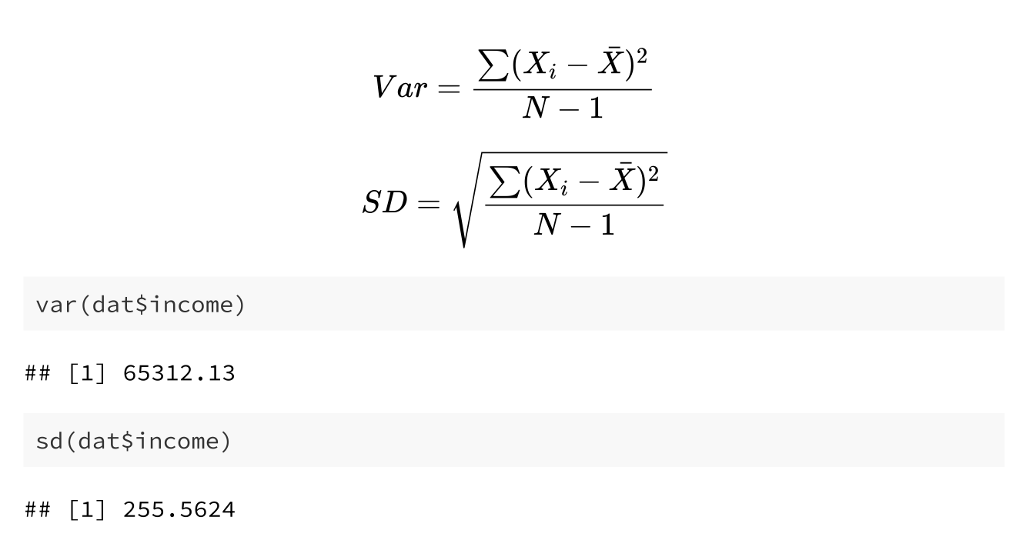
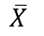
Measures of Center: Variance
Average sqaured distance from the data point to the data’s mean
The greater the value – the more spread out the data
$$\overline{X}$$

Slide 11
Measures of Center: Standard Deviation
Square root of the variance
Easier to understand (native units of measurement)
$$\overline{X}$$

Slide 12
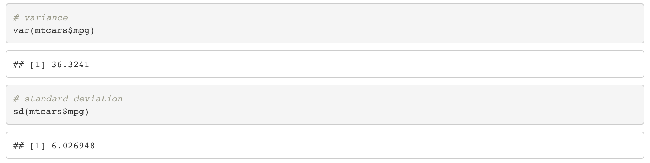
Measures of Spread: Standard Deviation

Slide 13
Measures of Spread: Quantiles
Ordered observations are partitioned into groups of equal size. The (observed) values which separate the groups are called quantiles.
Quartiles: equally sized groups consisting of 25% of observations each
Q₁ = Y_{.25}: The first quartile is the smallest observation for which holds that 25% of all observations are smaller or equal to it.
Q₂ = Y_{.50}: The second quartile is the smallest observation for which holds that 50% of all observations are smaller or equal to it.
Q₃ = Y_{.75} : The third quartile is the smallest observation for which holds that 75% of all observations are smaller or equal to it.

Slide 14
Measures of Spread: Quantiles
The construction principle is similar for other quantiles:
Quintiles: Y_{.2}, Y_{.4}, Y_{.6} and Y_{.8} partition all observations into q = 5 equally sized groups consisting of 20% of observations each
Deciles: Y_{.1}, Y_{.2},…, Y_{.8} and Y_{.9} partition all observations into q = 10 equally sized groups consisting of 10% of observations each
Percentiles: more generally, Y_{p}, is the p percentile; Y_{p} is the smallest value for which holds at least p of observations that are smaller than or equal to Y_{p}

Slide 15
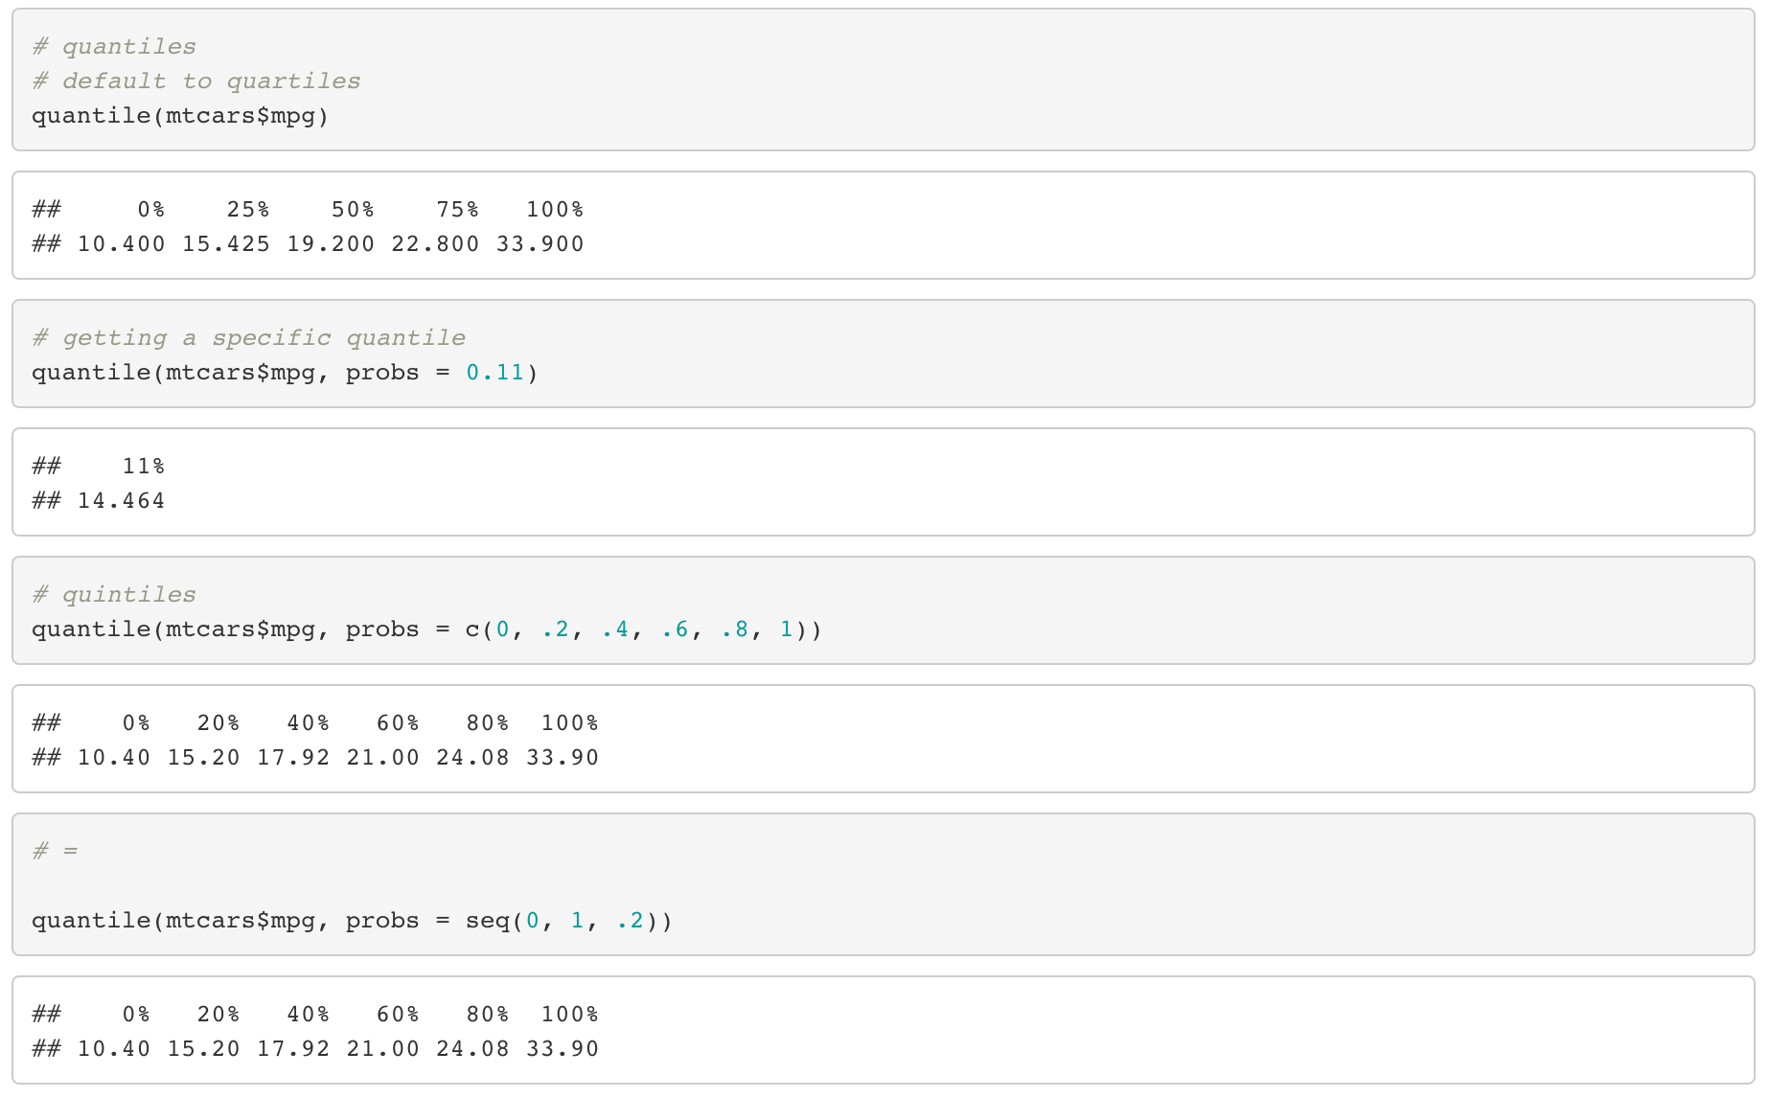
Measures of Spread: Quantiles

Slide 16
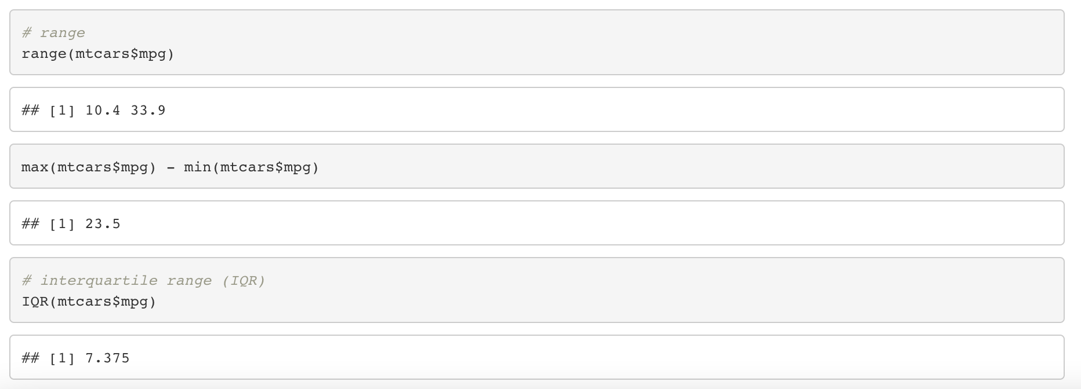
Measures of Spread: Range and IQR
Range: difference between max value and minimum value
IQR: difference between Q₃ and Q₂ (e.g.,the ‘mid-spread’)

Slide 17
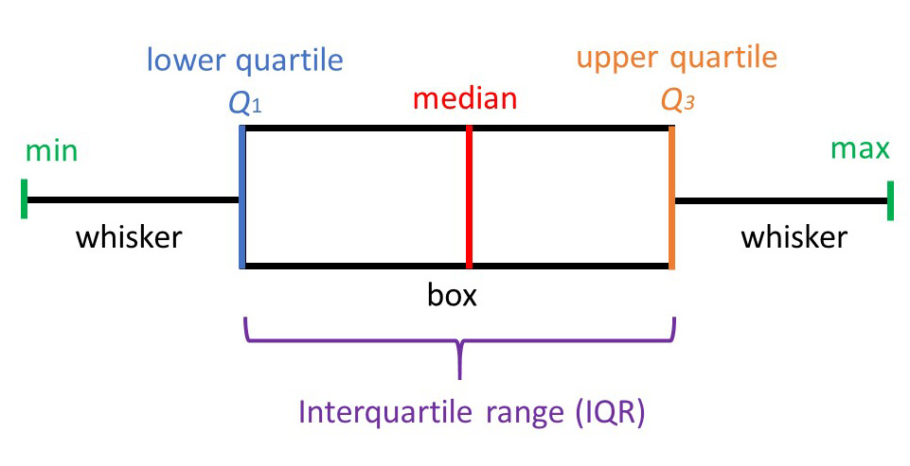
Measures of Spread: Boxplot

Slide 18
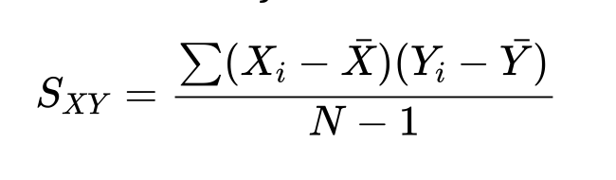
Covariance
Covariance measure the co-variation of X and Y
e.g., to what extent and in which direction does Y co-vary with X?

Slide 19
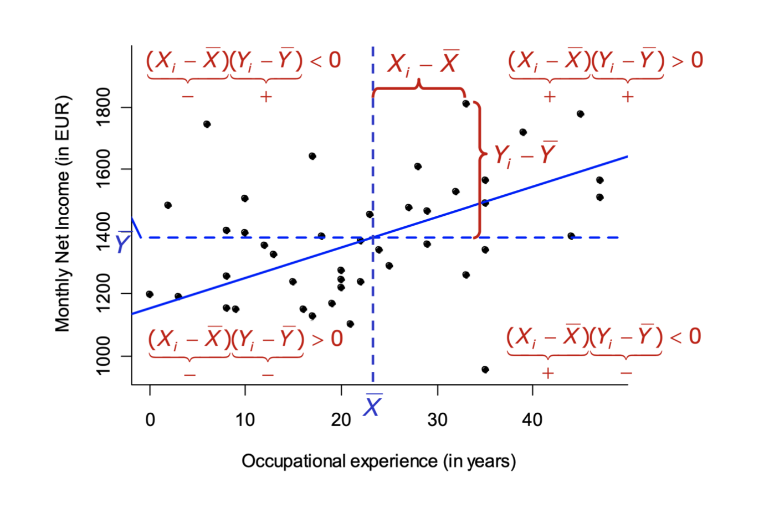
Covariance

Slide 20
Covariance
Again, S_{XY} measures the co-variation of X and Y, e.g., to what extent and in which direction does Y co-vary with X?
S_{XY} > 0 : positive relation (Y increases with increasing X); slope of the regression line is positive
S_{XY} < 0 : negative relation (Y decreases with increasing X); slope of the regression line is negative
S_{XY} = 0: no relation (Y varies independent of X; X is independent of Y); slope of the regression line is zero

Slide 21
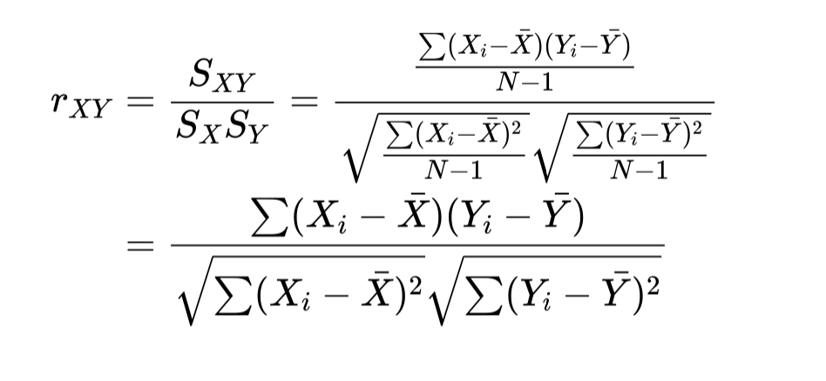
Correlation
The covariance depends on the units of measurement and is frequently not easy to interpret
However, we can use the covariance to construct a standardized measure that indicates the strength of the linear relationship between two continuous variables X and Y : the correlation coefficient

Slide 22
Correlation
The correlation coefficient represents a standardized covariance and is always between –1 and +1.
We use the correlation coefficient for assessing the strength of the linear relationship between X and Y:
r_{XY} = 1 indicates a perfect positive linear relationship.
r_{XY} = -1 indicates a perfect negative linear relationship.
r_{XY} = 0 indicates that there is no (linear) relationship.

Slide 23
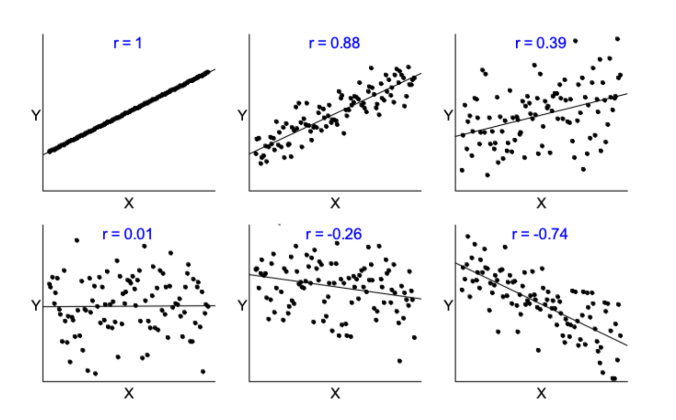
Correlation

Slide 24
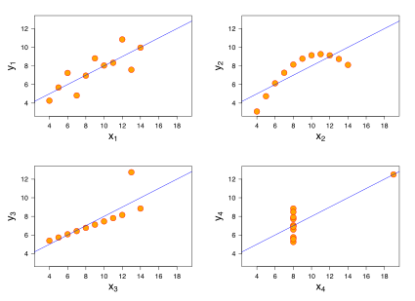
Correlation
The correlation coefficient is appropriate for (most) linear relationships. Whenever relations deviate from linearity the linear correlation is misleading.
Examples where the simple correlation coefficient is not really informative:

